Slide 1
Orthogonal Vector
Hung-yi Lee

Slide 2
Orthogonal Set
A set of vectors is called an orthogonal set if every pair of distinct vectors in the set is orthogonal.
Reference: Chapter 7.2
An orthogonal set?
By definition, a set with only one vector is an orthogonal set.
Is orthogonal set independent?

Slide 3




Independent?
Any orthogonal set of nonzero vectors is linearly independent.
Let S = {v₁, v₂, …, v_{k}} be an orthogonal set v_{i} ≠ 0 for i = 1, 2, 😐, k.
Assume c₁, c₂, …, c_{k} make c₁v₁ + c₂v₂ + ☹ + c_{k}v_{k} = 0
= 0
c_{i} = 0
$$≠0$$
$$c_{1}=c_{2}=⋯=c_{k}=0$$

Slide 4



Orthonormal Set
A set of vectors is called an orthonormal set if it is an orthogonal set, and the norm of all the vectors is 1
Is orthonormal set independent?
Yes
$$\frac{1}{\sqrt{14}}\left[\begin{aligned}1 \\ 2 \\ 3\end{aligned}\right]$$
$$\frac{1}{\sqrt{3}}\left[\begin{aligned}1 \\ 1 \\ −1\end{aligned}\right]$$
$$\frac{1}{\sqrt{42}}\left[\begin{aligned}5 \\ −4 \\ 1\end{aligned}\right]$$
A vector that has norm equal to 1 is called a unit vector.

Slide 5

Orthogonal Basis
A basis that is an orthogonal (orthonormal) set is called an orthogonal (orthonormal) basis
$$\left[\begin{matrix}1 & 0 & 0 \\ 0 & 1 & 0 \\ 0 & 0 & 1\end{matrix}\right]$$
Orthogonal basis of R³
Orthonormal basis of R³

Slide 6
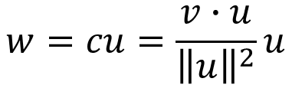





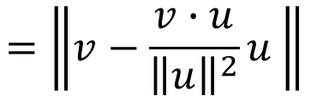


Orthogonal Projection
Orthogonal projection of a vector onto a line
$$z∙u=0$$
v
v: any vector
u: any nonzero vector on L
w: orthogonal projection of
v onto L , w = cu
z: v − w
z
L
z
u
w
$$\left(v−w\right)∙u$$
$$=\left(v−cu\right)∙u$$
$$=v∙u−cu∙u$$
$$=v∙u−c{\left\|u\right\|}^{2}$$
$$c=\frac{v∙u}{{\left\|u\right\|}^{2}}$$
$$w=cu=\frac{v∙u}{{\left\|u\right\|}^{2}}u$$
=0
Distance from tip of v to L :
$$=\left\|v−\frac{v∙u}{{\left\|u\right\|}^{2}}u \right\|$$
$$\left\|z\right\|=\left\|v−w\right\|$$
Notes:
W in terms of u
Tip: 頂端；尖端

Slide 7




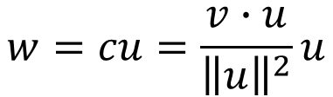
Orthogonal Projection
$$c=\frac{v∙u}{{\left\|u\right\|}^{2}}$$
$$w=cu=\frac{v∙u}{{\left\|u\right\|}^{2}}u$$
Example:
v
z
L
L is y = (1/2)x
z
u
w
$$v=\left[\begin{aligned}4 \\ 1\end{aligned}\right]$$
$$u=\left[\begin{aligned}2 \\ 1\end{aligned}\right]$$
$$z∙u=0$$
Notes:
$$w=\frac{v∙u}{{\left\|u\right\|}^{2}}u$$
$$=\frac{9}{5}\left[\begin{aligned}2 \\ 1\end{aligned}\right]$$
$$\left\|\left[\begin{aligned}4 \\ 1\end{aligned}\right]−\frac{9}{5}\left[\begin{aligned}2 \\ 1\end{aligned}\right]\right\|$$
$$=\frac{1}{5}\left\|\left[\begin{aligned}2 \\ −4\end{aligned}\right]\right\|$$
$$=\frac{2}{5}\sqrt{5}$$

Slide 8
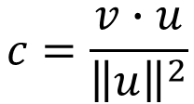









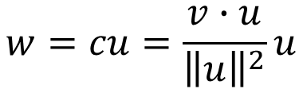
Orthogonal Basis
$$c=\frac{v∙u}{{\left\|u\right\|}^{2}}$$
$$w=cu=\frac{v∙u}{{\left\|u\right\|}^{2}}u$$
Let $S=\left\{v_{1},v_{2},⋯,v_{k}\right\}$ be an orthogonal basis for a subspace V, and let u be a vector in V.
$$u=c_{1}v_{1}+c_{2}v_{2}+⋯+c_{k}v_{k}$$
$$\frac{u∙v_{1}}{{\left\|v_{1}\right\|}^{2}}$$
$$\frac{u∙v_{2}}{{\left\|v_{2}\right\|}^{2}}$$
$$\frac{u∙v_{k}}{{\left\|v_{k}\right\|}^{2}}$$
Proof
To find $c_{i}$
$$u∙v_{i}=\left(c_{1}v_{1}+c_{2}v_{2}+⋯+c_{i}v_{i}+⋯+c_{k}v_{k}\right)∙v_{i}$$
$$=c_{1}v_{1}∙v_{i}+c_{2}v_{2}∙v_{i}+⋯+c_{i}v_{i}∙v_{i}+⋯+c_{k}v_{k}∙v_{i}$$
$$=c_{i}\left(v_{i}∙v_{i}\right)$$
$$=c_{i}{\left\|v_{i}\right\|}^{2}$$
$$c_{i}=\frac{u∙v_{i}}{{\left\|v_{i}\right\|}^{2}}$$

Slide 9
Example
Example: S = {v₁, v₂, v₃} is an orthogonal basis for R³

Slide 10
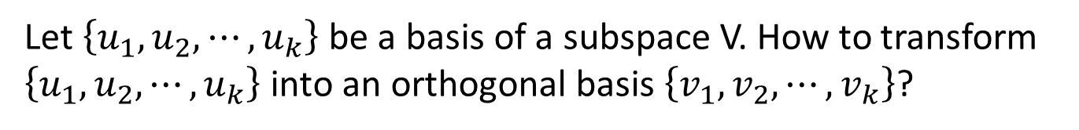
Orthogonal Basis
Let $\left\{u_{1},u_{2},⋯,u_{k}\right\}$ be a basis of a subspace V. How to transform $\left\{u_{1},u_{2},⋯,u_{k}\right\}$ into an orthogonal basis $\left\{v_{1},v_{2},⋯,v_{k}\right\}$?

Slide 11
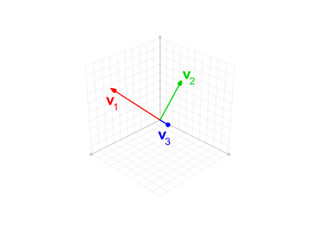
Visualization
https://www.youtube.com/watch?v=Ys28-Yq21B8

